Slide 1
Think Pharmacy – Nine treatable skin conditions
Dr Stephanie Gallard
Dermatology GPSI

Slide 2
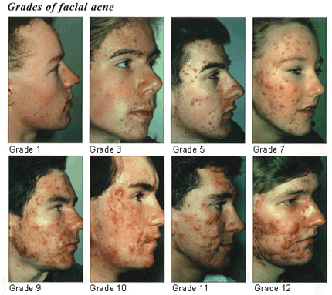
1. Acne vulgaris The most subjective skin condition in the world….

Slide 3
All about acne…
Usually begins at puberty
Often a family history
Boys worse, girls more affected
Dihydrotestosterone stimulates oil glands => sebum
Colonization of oil glands by Propobionibacterium Acnes
Subsequent inflammation, comedones and pustules
Eventual scarring

Slide 4
Benzyl Peroxide 5/10%
For mild acne
Antiseptic, anti-inflammatory, keratolytic and comedolytic
Ask about previous treatments
Check skincare regime – avoid mineral oil (esp wipes!)
Diet makes no difference
Beware the enthusiastic user
Bleaches!
Can take a few months….
No use if extensive papules or pustules present
Previous antibiotics already
Hormonal problems?
Scarring needs Roaccutane
Signs of psychosocial distress

Slide 5
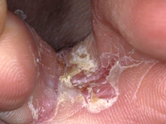
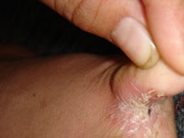
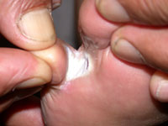
2. Athlete’s foot for which one does not need to be athletic at all
Fungal infection
Usually cleft between 4th/5th toe
Moist, soft, macerated
And smelly!
Red, itchy, sore
Check for….
Occlusive footwear
General foot hygiene
Sole and upper foot technically is Tinea Pedis

Slide 6
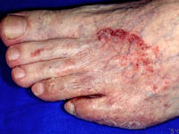
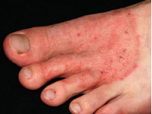
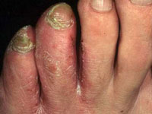
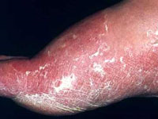
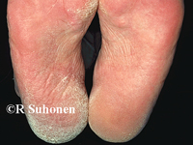
Clotrimazole 1%/Miconazole 2% antifungal AND antibacterial
Foot hygiene comes first!
Daily/twice daily bathing
Dry between toes, cotton socks
Change of footwear or bare feet
Use until cleared – and the week afterwards
But not if under 1/preg or b/f
Diabetic or PVD
Toenails (esp nail bed) affected
Immunocompromised….

Slide 7
3. Dermatitis/Eczema Greek – boiling over, breaking out “the itch that rashes”
Affects 1 in 5 of us
Multifactorial condition… Dermatological and immunological components
ATOPIC – constitutional, inherited – 14-24% population
IRRITANT – lack of oil in skin – constant handwashing, soaps, disinfectants, detergent or chemical use without hand protection
ALLERGIC – immune reaction caused by agent in contact with the skin – eg cosmetics, hair dye, nickel, plants
Your inclusion criteria “superficial inflammation of the skin, causing itching, with a red rash”

Slide 8
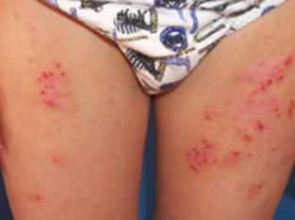
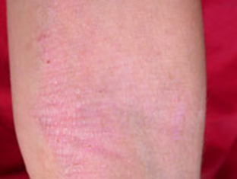
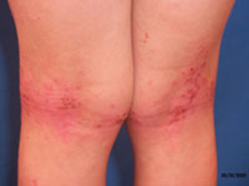
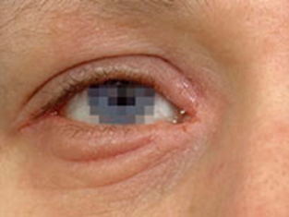
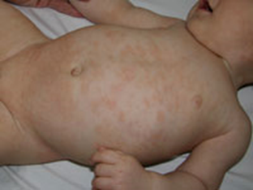
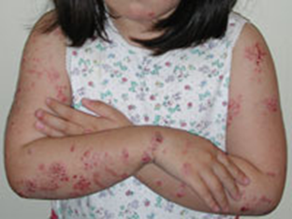
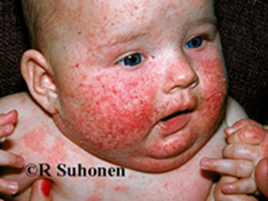
Atopic dermatitis
From allergic disease, to barrier disease
UK has increasing prevalence
Decreased expression of filaggrin gene => hyperlinear palms
Impaired barrier function
Decrease in NMF
Increased staph aureus entry

Slide 9
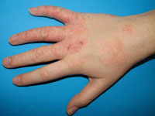
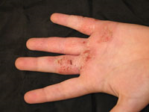
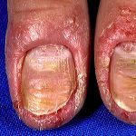
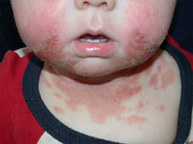
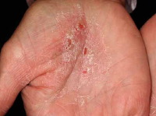
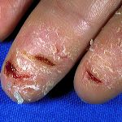
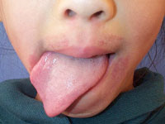
Irritant dermatitis – usually hands Beware the unilateral hand eczema!!
Irritants remove protective surface oils and NMF
This allows deeper penetration of irritant
Which triggers inflammation
Consider amount and strength of irritant, and length and frequency of exposure
Usually work related – esp hairdressers
Good self care is vital
Beware secondary bacterial superinfection

Slide 10
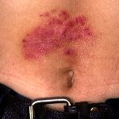
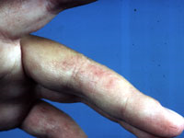
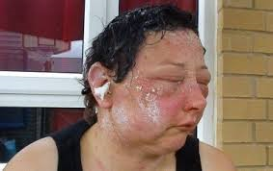
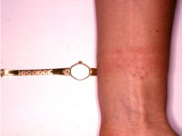
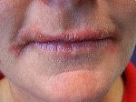
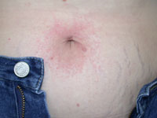
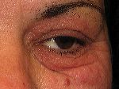
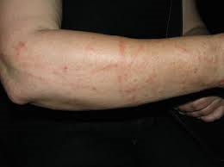
Allergic contact dermatitis I’ve always used that hair dye….
Tiny amount of skin contact with an allergen to which there has often been previous sensitisation
Can be extreme – and disfiguring
Consider photo-allergies too
Can usually give a good history
Itchy, acutely blistering, weeping crusted and sore

Slide 11
Hydrocortisone 1% (if over 10) Emulsifying ointment
Judgement call
Previous history, previous effective therapies
Maximum of 7 days allowed
Emollient, emollient, emollient….
Avoid detergents or other aggravating factors
Consider antihistamine
Fingertip units…
But not if
weeping, crusting, thickening
Untreated infection
Seborrheic/other eczema
Psoriasis
Face/genitalia/axillae
SEVERE eczema
Scabies
Pregnancy

Slide 12
What is a fingertip unit?
Notes:
Finger tip rule 30 g of cream is approximately enough to cover the adult body once, each finger tip is 0.5g. One 30 g tube = 60 ftu
30 g of cream is approximately enough to cover the adult body once, each finger tip is 0.5g. One 30 g tube = 60 ftu
And don’t forget an adult will use 500g emollient/week, 2kg month….

Slide 13
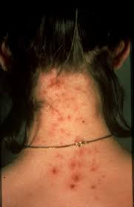
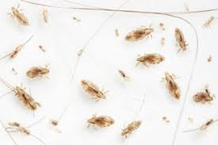
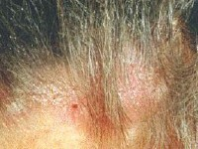
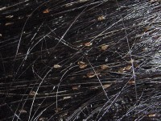
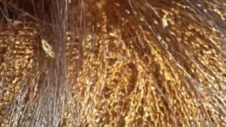
4. Head lice – Pediculus capitis itchy head all afternoon then?
1-3mm long louse adapted to live attached to hair shafts
Feeds on human blood
Bites leave irritant saliva
Need close head to head contact for transmission
Die after 1-2 days off scalp
Eggs laid close to scalp – hatch after 8 days, mature at 10 days – and lays 6 eggs per day after that
Hatched eggs are paler…

Slide 14
Bug busting kit/Hedrin 4% as long as you have seen live lice
Comb, comb, comb… 30mins
Every 4 days, for two weeks
Mechanical destruction
“break their legs and they lay no eggs”
Buckets of any conditioner
Calendars and stickers?
I like Nitty Gritty combs
Suffocating agent
Dry hair, root to tip
8hours to overnight
Repeat in 7 days
And don’t smoke whilst applying
Tea tree oil
Cut hair off!
Ivermectin….
Ongoing battle
Refer if severe or resistant

Slide 15
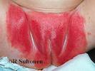
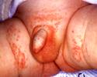
5. Nappy Rash irritant contact dermatitis of the under nappy area
Caused by the incontinence seen extremes of life
Urine under occlusion leads to macerated skin
Colonized by various – but especially candida
Faecal bile salts/enzymes break down skin integrity
Urine & faeces => ammonium hydroxide…

Slide 16
Sudocrem 60g as long as mild to moderate red rash, confined to nappy area
Frequent nappy changes
Leave nappy-free if possible
Don’t over bathe
Avoid perfumed anything
Consider wipe allergy
Juices increase stool acidity?
But refer on if…
Broken or ulcerated skin
Severe fungal infection, or in conjunction with oral thrush
Truly distressed baby ?with temp
Should improve in 48hours
And not last longer than 10days

Slide 17
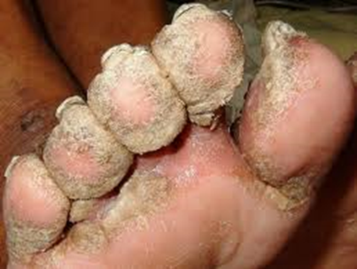
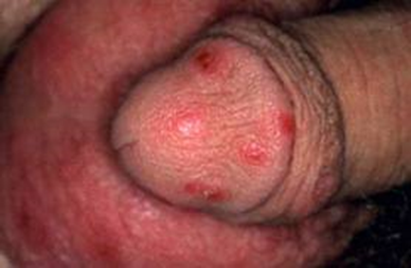
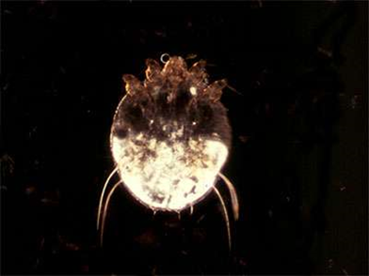
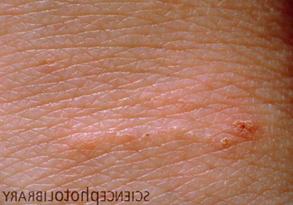
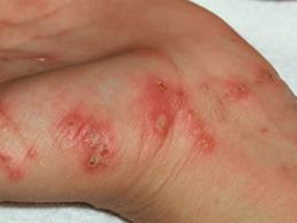
6. Scabies – Sarcoptes scabiei
A mere 10-12 adult mites…
4 weeks to incubate
Females lay 3 eggs/day for 1-2/12
No problems for the first few weeks…
Check contacts, finger webs and genitalia if possibile
Burrows are hard to find
Nodules of the penis are diagnostic
Beware nursing homes
Need skin to skin contact
Secondary eczema is VERY common

Slide 18
Permethrin dermal cream as long as over 2 years and sure of diagnosis
Apply to whole body, overnight
No need to bath first – need cool skin
Especially webs of fingers/toes, genitalia, any skin creases
Repeat in a week
Treat whole family at once
Boil wash all bedlinens etc
Beware post treatment itch!
Always worse at night…
I tend to give 100g Eumovate cream
Don’t forget outbreaks in nursing or residential homes have to be reported to Public Health
Systemic ivermectin

Slide 19
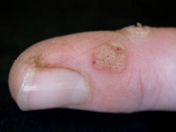
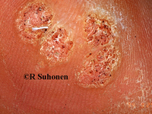
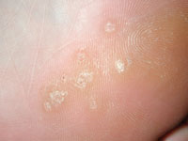
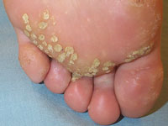
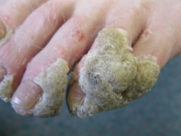
7. Warts and Verrucas They just won’t shift Doctor….
HPV infection
Bane of childhood – and GPs
Direct contact sheds virus particles
Esp when pick, nibble or chew
Look for the black dot of end on BV
Will resolve eventually (50% 1 year, 2/3 within 2 years)
Persistence, shaving, applying stuff
Duct tape and banana skin…
Beware – immunosuppression and consanguineous children
No official services exist for referral

Slide 20
Salactol wart paint as long as over 1, not on or near face/anogenital area, infected or bleeding, too numerous and sure of diagnosis!
HPV leads to overgrowth and non shedding of keratin
Excess skin must be pared away
Soak, then pumice/emery board
Encircle with Vaseline before application if sensitive skin
Can take AGES
Persistence is everything…
Refer on if…
Diabetic, PVD
2 years treatment!
What else?
Occlusal, cryotherapy
Imiquimod
Efudix
Laser!

Slide 21
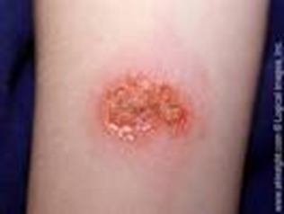
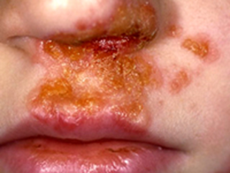
8. Impetigo PGD for small acute localised lesions….
Staphylococcus aureus or streptococcus pyogenes infection
Yellowy golden crust
Often facial/around mouth
Starts with minor skin injury
Highly contagious, stay off school/nursery
Separate towels and flannels
Over one year of age
Maximum of two lesions, each no bigger than a one pence piece

Slide 22
Fusidic acid 2% cream
UNLESS??
Large areas
Underlying eczema or scabies
Systemically unwell
Immunocompromised
Allergic or resistant to Fucidin
Already on antibiotics, or treated already
Pregnant or breastfeeding
Don’t forget to soak away the crust
Give the BAD impetigo leaflet…

Slide 23
9. Nipple candida in breast feeding mothers PGD
For b/f mums who have a baby being treated for oral thrush under Minor Ailments already
Systemically well person
Red/flaky/shiny nipples
Cracked, non-healing
Burning, tender – and a soreness after initially pain free b/f
After every feed for two weeks.
BUT NOT IF….
Pyrexial, with red/inflamed/tender breasts (mastitis??)
Deep aching breast pain
Warfarinised, or hypersensitivity to ingredients
Previous tx, or recurrence within 8 weeks

Slide 24
Is it cow’s milk, Doctor??
Filaggrin also associated with allergic asthma and peanut allergy
Food allergy (wheat/egg/cow milk protein/soya) commoner in children
Study – 80-90% could tolerate food their blood tests said allergic to
Very high percentage of false reaction
Cow milk allergy has 100% cross reactivity to goat and sheep milk!
Changed advice – give the food early, stops the allergy
Avoid the food 3-4 weeks, reintroduce slowly, see what happens
If milk allergics get baked milk – outgrow allergy in 5 years
If avoid all milk – only 30% do
For food – oral tolerance induction – if bake milk/soya/wheat/egg – the protein denatures and is less allergic
This does NOT work for nuts or fish!

Slide 25
Death by Aqueous cream
Never as a leave on emollient
Soap substitute at best
Contains SLS – sodium lauryl sulphate
Irritant and drying
Cheap!!
Notes:
Mention how been going since 1950s
And when it started we were using arsenic for psoriasis!
Will get some cost differentials from Drug tariff etc – compare it to Aveeno?

Slide 26
Shingles – Herpes Zoster
VZ infection in childhood - chickenpox
Spots clear, virus doesn’t
Lies dormant in dorsal horn of spinal column….
Immunosuppression!
+> pain, blisters, rash
Dermatomal distribution
Unilateral nerve pathway
Lasting 3-4 weeks

Slide 27
Shingles – actions needed?
Mersey formulary says antiviral tx is not recommended for under 14 yrs for chicken pox
And not for shingles under 60 years
But refer URGENTLY if suspected ocular involvement

